Slide 1
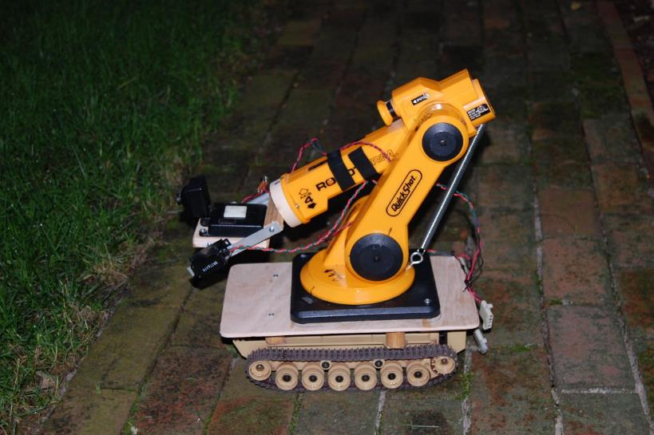
Robotics Lifting Things
LabRat Scientific
© 2018

Slide 2
There are many different ways to lift things. Some can be quite simple while others can be very complex and complicated.
This lesson identifies a few methods and provides some analysis that can be used to give you an idea of the torques and moments you will need to overcome to accomplish your lifting tasks…
Once you have an idea of the torques needed you can select the correct motor (and gearing system) for the job.

Slide 3
Telescoping Lifter
A
B
C
Sliding masts and a cable/pulley system can be used to lift items vertically. Significant extension is possible using this concept.

Slide 4
Telescoping Lifter
Sliding mast moves upwards
Multiple sliding masts can be used to make the system reach higher
Pull down on cable (using a winch)
Cable pulls up on the base of the sliding mast

Slide 5
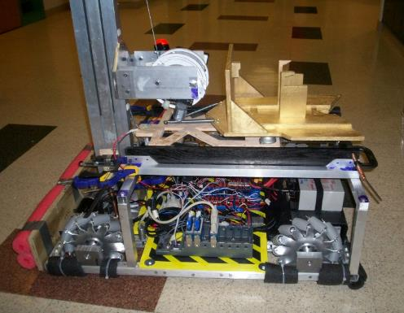
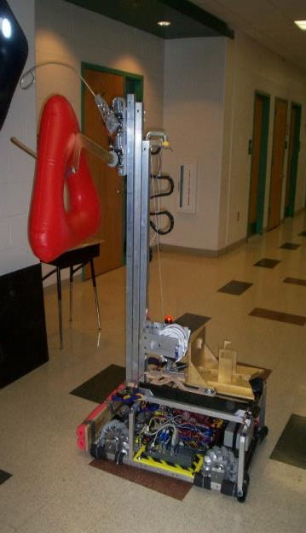
Winch
Telescoping Mast
Cable winch used to pull down on the cable. Gravity was sufficient to lower the arm when the winch was operated in reverse.

Slide 6
The winch needs to be able to lift the weight of the mast sections, the load, and overcome any friction.
The weight of the mast(s) and load create a tension in the cable. The winch needs to counteract this tension (and more) to lift the system upward.
8.0 lbs
Example: If the winch had a 0.25 ft (3.0 in) radius cable spool, the torque needed to provide the 8.0 lb tension force in the cable is calculated as follows:
0.24 ft
Torque = Force x Distance
Torque = 8.0 lbs x 0.25 ft
Torque = 2.0 ft*lbs

Slide 7
Objects can also be lifted using a pivoting boom system as shown in the diagram.
Motor & Gear
A

Slide 8
There are several methods that can be used to raise and lower the boom
Chain and Sprockets
Fairly fast action time
Fairly simple
Unlimited “stroke”
Most versatile as far as positions are concerned
Torque could be an issue
Limit switches and mechanical stop used to stop in vertical and horizontal positions

Slide 9
There are several methods that can be used to raising and lowering the boom
Pneumatic Piston
Fastest action time (maybe too fast!)
Fairly simple
Limited “stroke”
Air pressure supply may be issue (pump and supply tank needed)
Limit switches and mechanical stop used to stop in vertical and horizontal positions

Slide 10
There are several methods that can be used to raising and lowering the boom
Cable and Winch
Slowest action time
Least complex
Unlimited “stroke”
Limit switches and mechanical stop used to stop in vertical and horizontal positions

Slide 11
Moments
If the crane boom concept is used, the system will have to be able to handle the “moment” created by the load that is being lifted.
A moment is created when some force (a load) is applied at a distance from a point of rotation (Point A in the diagram).
20 ft
A
10 lbs
Massless beam with 10 Lb load located 20 ft from the pivot point?
Moment = Distance x Load = 20 ft x 10 lbs = 200 Ft*lbs

Slide 12
The system used to raise the boom must be able to overcome the moment created by the boom length and the load being lifted.
Action point of the object being lifted
Action point of the mass of the boom (Boom CG)
Motor & Gear
A
The mass “A” tries to rotate the boom down…
The crane boom also has mass, and thus it also tries to rotate the boom downward.

Slide 13
The system used to raise the boom must be able to overcome the moment created by the boom length and the load being lifted.
Action point of the object being lifted
Action point of the mass of the boom (Boom CG)
Motor & Gear
A
The motor/gear torque must counteract the moments that are caused by the load and the boom…

Slide 14
Example Problem:
Action point of the object being lifted
Action point of the mass of the boom (Boom CG)
Motor & Gear
A
D1
D2
A moment is created when a load (force) is acting at some distance from a defined point of interest.

Slide 15
Moment₁ = 2 ft x 2 lbs = 4 ft*lb
Moment₂ = 4 ft x 5 lbs = 20 ft*lb
2 lbs
Motor & Gear
5 lbs
2 ft
4 ft
Moment _{Total} = 4 ft*lb + 20 ft*lb = 24 ft*lb

Slide 16
A torque of 24 ft*lbs is needed to support boom and load in this position.
20 ft* lbs
4 ft* lbs
24 ft* lbs
Motor & Gear
A torque greater than 24 ft*lbs is needed to get the boom to rotate upwards (Newton says an imbalanced force is needed to change the motion of the boom).

Slide 17
The moment (or torque) required to rotate the boom will change as the angle of the boom changes. As the boom rotates upwards it gets easier to lift…
2 lbs
5 lbs
2 ft
4 ft

Slide 18
The moment (or torque) required to rotate the boom will change as the angle of the boom changes. As the boom rotates upwards it gets easier to lift…
2 lbs
5 lbs
Shorter
Shorter
As the boom angle increases, the horizontal distance between the loads and the pivot point decreases.

Slide 19
The new horizontal distances used to calculate the moments are determined using some basic Algebra.
Recall from basic Algebra:
Opp
Sine = ---------
Hyp
Known Distance (D)
Adj
Cos = ---------
Hyp
Y = D * Sine (Ang)
Angle
In this particular case, we want to use the horizontal distance…
X = D * Cos (Ang)

Slide 20
The moment (or torque) required to rotate the boom will change as the angle of the boom changes.
As the boom rotates upwards it gets easier to lift…
Fixed Length – does not change
NOTE: This horizontal position will require the highest torque (moment).
2 lbs
2 ft
5 lbs
4 ft
Moment = ( 2 ft x 2 lbs ) + ( 4 ft x 5 lbs ) = 4 ft*lbs + 20 ft*lbs = 24 ft*lbs

Slide 21
As the boom elevates, the angle increases.
4.0 Ft
(fixed length)
2.0 Ft
(fixed length)
5 lbs
2 lbs
45 Deg
A
B
So the moments (and required torque) are a function of the boom angle.

Slide 22
Doing the Math…
Distance A = 2.0 Ft x Cos (45)
= 2.0 Ft x 0.707
= 1.4 FT
Distance B = 2.0 Ft x Cos (45)
= 4.0 Ft x 0.707
= 2.8 FT

Slide 23
The horizontal distances for the boom CG and the load have become shorter…
As a result, the moments created by the boom and the load are reduced…
5 lbs
2 lbs
45 Deg
The math indicates that the moment is less…
1.4 ft
2.8 ft
Moment = ( 1.4 ft x 2 lbs ) + ( 2.8 ft x 5 lbs ) = 2.8 ft*lbs + 14 ft*lbs = 16.8 ft*lbs

Slide 24
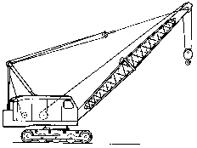
The boom can be lifted using a winch and cable instead of a motor acting at the pivot point…

Slide 25
The following process can be used to calculate the pulling force on the cable that is needed to support the boom and load.
A
Tension
5 lbs
2 lbs
We will assume the cable is at a 30 deg angle relative to the horizontal…
We will use the previous scenario where the boom is at a 45 degree incline.
30 Deg
45 Deg
1.4 ft
2.8 ft

Slide 26
The lifting cable is attached at Point A which is 3.0 feet up the boom.
A
30 Deg
3.0 Ft
Moment_{Load} = 16.8 ft*lbs

Slide 27
Step 1 – determine the force that is needed at Point A to counteract the 16.8 ft*lb moment created by the loads.
A
30 Deg
3.0 Ft
Moment_{Load} = 16.8 ft*lbs
For this step, the force at Point A is assumed to be perpendicular to the boom as shown by the red arrow.

Slide 28
Step 1 – determine the force that is needed at Point A to counteract the 16.8 ft*lb moment created by the loads.
A
Moment = Force x Distance
Moment
Force = -----------------
Distance
30 Deg
3.0 Ft
16.8 ft * lbs
Force = -----------------
3.0 ft
Force = 5.6 lbs
Moment_{Load} = 16.8 ft*lbs

Slide 29
Step 2 – Use geometry and trigonometry to determine the force in the cable (a.k.a. tension).
5.6 lbs
A
30 Deg
3.0 Ft
Moment_{Load} = 16.8 ft*lbs

Slide 30
Step 2 – Use geometry and trigonometry to determine the force in the cable (a.k.a. tension).
First, let’s simplify the diagram so things aren’t so cluttered…
5.6 lbs
A
Be warned, the geometry is going to get a little complicated…
30 Deg
3.0 Ft

Slide 31
Step 2 – Use geometry and trigonometry to determine the force in the cable (a.k.a. tension).
5.6 lbs
A
The boom was at a 45 Deg incline, so we know this angle…
30 Deg
45 Deg

Slide 32
Step 2 – Use geometry and trigonometry to determine the force in the cable (a.k.a. tension).
Now let’s start determining various angles based on geometry concepts…
5.6 lbs
A
We can use geometry to determine that this angle is 135 Deg.
Ang = 180 Deg - 45 Deg
135 Deg
30 Deg
45 Deg

Slide 33
Step 2 – Use geometry and trigonometry to determine the force in the cable (a.k.a. tension).
5.6 lbs
A
We can use geometry once again to determine that this angle is 15 Deg.
The internal angles in a triangle add up to 180 Deg
15 Deg
135 Deg
30 Deg
45 Deg

Slide 34
Step 2 – Use geometry and trigonometry to determine the force in the cable (a.k.a. tension).
5.6 lbs
A
Since the force at Point A is perpendicular to the boom (red line), we can determine this angle is 75 Deg.
Angle = 90 Deg – 15 Deg
75 Deg
15 Deg
135 Deg
30 Deg
45 Deg

Slide 35
Step 2 – Use geometry and trigonometry to determine the force in the cable (a.k.a. tension).
Adj
Cos (ϴ ) = -----------
Hyp
Adj
Hyp = -----------
Cos (ϴ)
Adjacent
5.6 lbs
90
5.6 lbs
Hyp = -----------
Cos (75)
75
15
Hypotenuse
5.6 lbs
Hyp = -----------
0.25
Hyp = 22.4 lbs

Slide 36
Step 2 – Use geometry and trigonometry to determine the force in the cable (a.k.a. tension).
Adj
Cos (ϴ ) = -----------
Hyp
Adj
Hyp = -----------
Cos (ϴ)
Adjacent
5.6 lbs
90
5.6 lbs
Hyp = -----------
Cos (75)
75
15
22.4 lbs
5.6 lbs
Hyp = -----------
0.25
Hyp = 22.4 lbs

Slide 37
Step 2 – Use geometry and trigonometry to determine the force in the cable (a.k.a. tension).
The winch needs to pull on the cable with 22.4 lbs of force to support the boom and load.
A
22.4 lbs
The torque needed to be generated by the winch depends on the physical make-up of the winch system (e.g. motor, gears, and diameter of the cable spool).
30 Deg
3.0 Ft
Moment_{Load} = 16.8 ft*lbs

Slide 38
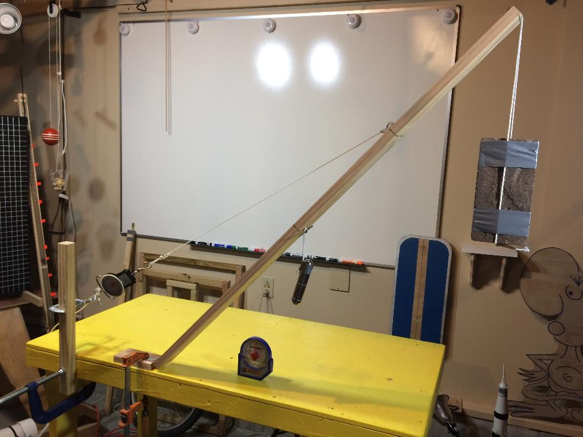
Now that is some confusing math and geometry. How do we know it is correct?
This experiment was set up to mimic the model in the analysis. The angles and loads were very close to the analysis and the experimental solution was on the order of 22 lbs. The variation was due to slight errors in weights and angles as well as the accuracy of the fish scale used to measure the loads. But since the experimental result was very close to the theoretical analysis, the method can be considered valid.

Slide 39
Now that we know the load is correct, we can calculate the torque that is needed to make the system work.
22.4 lbs
If the winch has a 0.17 ft (2.0 in) radius cable spool, the torque needed to provide the 22.4 lb tension force in the cable is calculated as follows:
0.17 ft
Torque = Force x Distance
Torque = 22.4 lbs x 0.17 ft
Torque = 3.8 ft*lbs
The motor and gears selected to do this job need to provide more than this torque…

Slide 40
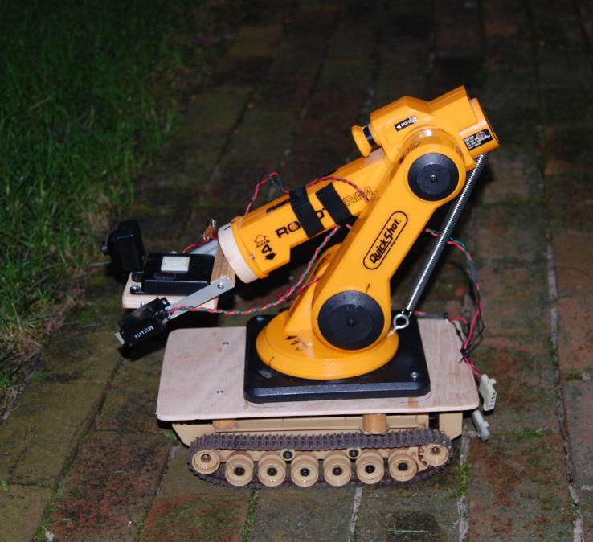
Springs can provide mechanical assistance if needed…
The motor in this robotic arm was not powerful enough to lift the load…
A tension spring was added to the system to assist the motor when the arm was raised. The spring stretch was optimized in this lowered position to provide just the right amount of force to assist the motor.
The load creates a counter clock-wise moment and the spring pulling on the back of the arm (aft of the pivot point) creates a clockwise moment to assist the motor.

Slide 41
Questions?

